Slide 1


The Battle of Trafalgar: Initial Model
Group 4: Sammer, Collin, Robert, Rich

Slide 2
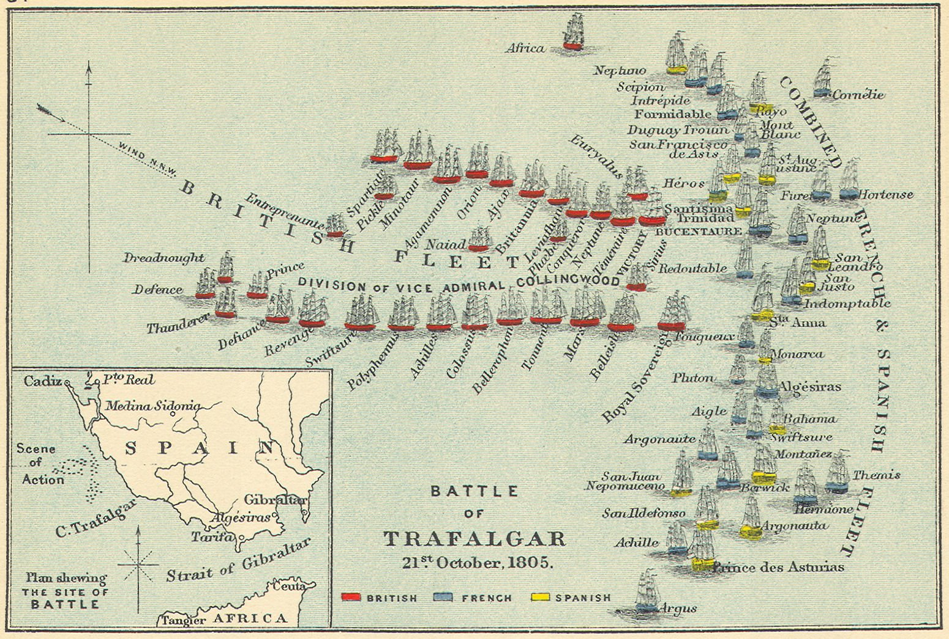
Introduction & Bottom Line
Last major battle at sea during the Napoleonic wars
Unorthodox naval battle strategies.
Zero British Ships lost
Britain vs. France + Spain
Notes:
Begin with an introduction and bottom line up front (approximately 1 min). What battle/issue does your group focus on? Why is this interesting and important? (Why should people want to continue watching this presentation?)

Slide 3
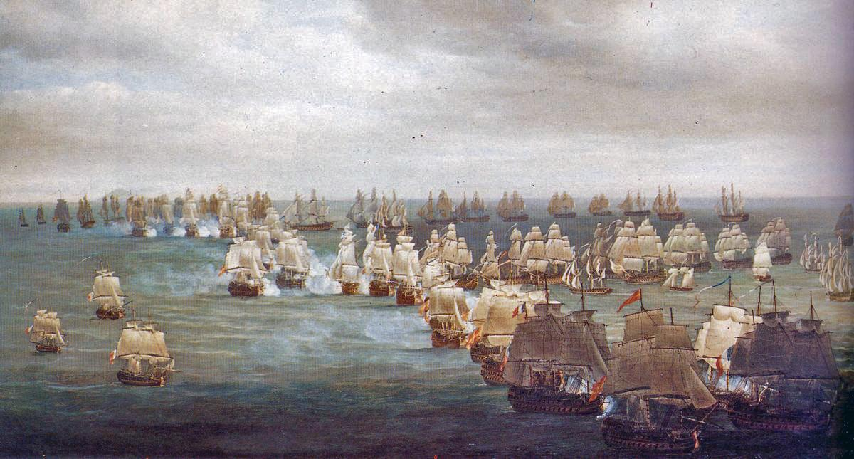
History & Context
The battle formation was unique for the times because the combatants were not facing each other, they were perpendicular when approaching their adversaries.
The traditional formation would have been to align the ships in parallel and fire from the side of the vessel
Spain and France outnumbered the British ships, but the British had more 1st and 2nd rate ships.
The vessel's speed, size, and hull thickness contributed to its rating
Nelson sent out a memo to his fleet the day prior, detailing his plan of two columns attacking as a “Crossing T” towards the flag ships
The T-formation approach (utilizing current wind conditions) Aiming at the flagships, both columns (using their wind advantage) broke the line of almost stationary French and Spanish boats
Notes:
Three naval fleets
Britain - Admiral Nelson
France & Spain - Admiral Villeneuve
Variety of reasons that the French should have won
Vessels designed to be faster
Better gunned, in size and range
Better hull thicknesses on average
British won due to a combination of factors
Wind direction
Crossing-T formation
Coordination prior to the battle
Targeted flagships
Provide relevant history and context (approximately 2 min). This section will be shorter than in your previous presentation (which was focused entirely on history and context). Just provide the details necessary for the audience to understand the relevance of your research question and evaluate your conceptual model plan (broader context, individuals and technology involved, timeline, etc.).

Slide 4
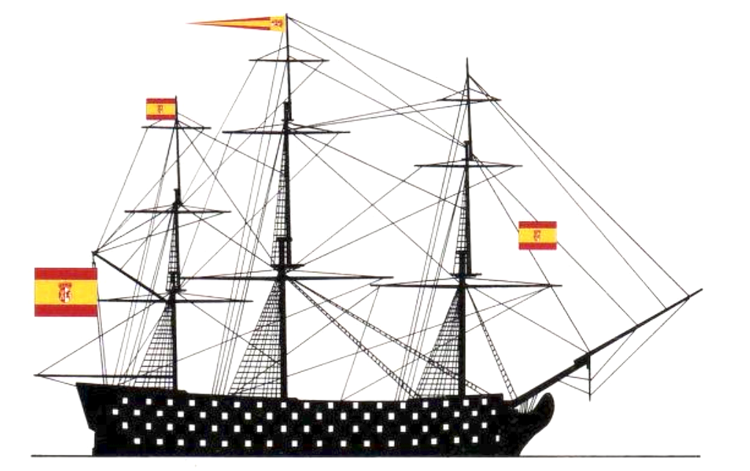
Research Question(s)
How does wind speed and direction affect…
A. The amount of time required to break the French line?
B. The amount of casualties inflicted on the British before breaking the line?
C. The effectiveness of the British’s “crossing-T” formation?
C. The outcome of the battle overall?
Notes:
State your research question (less than 1 min). Remember to incorporate feedback from earlier presentations. Be clear exactly what it is you’ll be examining/measuring.

Slide 5
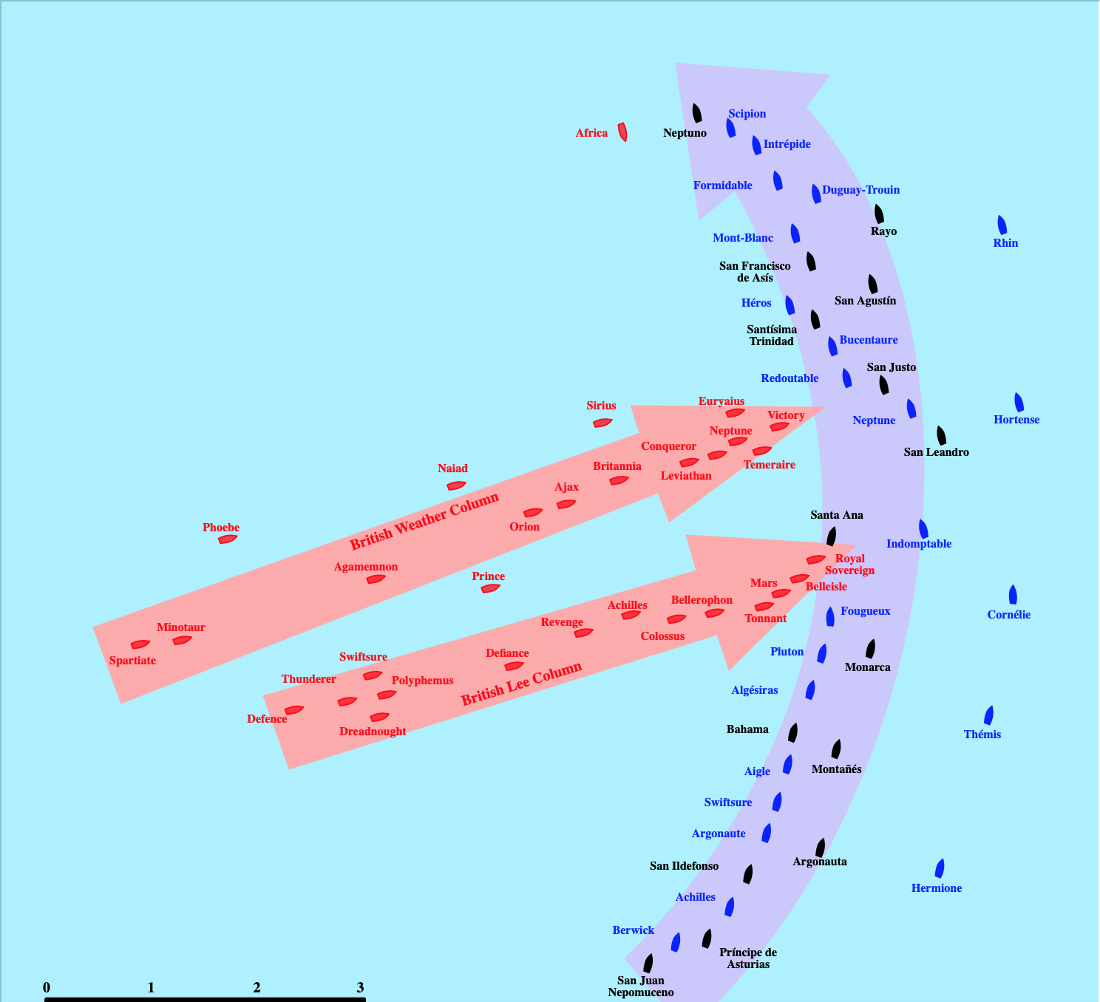
Conceptual Model: Overview
Scope:
Causalities
Ship losses
Ships (ratings, capabilities, resiliency)
Gun capabilities (caliber, range, rate of fire)
Wind (speed and direction)
Formation type (“crossing-T”, “H”, “Z”)
Resolution:
We want to approach this by a simple design approach by starting with minimal details and digging deeper. For example, the Ships will be categorized into 3 categories (e.g. ship rating, deck number, and firepower)
Structure:
The formation determines how the ships will fire at each other
The ship rating will determine its "life span"
Wind level will effect engagement strategy
Tactics at the time will determine the engagement criteria for each side
Notes:
Describe your conceptual model (5 min). How will your model work? The description should be detailed enough to allow the audience to verify that your model design will be adequate to answer your research question. Include the following information:
What are the key actors (agents) in your model? What are their parameters?
How will you model the environment?
What are the behaviors of the agents and how do they interact with each other and the environment? (Consider using flow diagrams/pseudo code)
What assumptions have you made in your model? Where are you using/will you use historical data?

Slide 6
Conceptual Model: Approach
Key Agents:
Ships
Key Factors
Wind Direction
Wind Speed
French Targeting of Masts (impact mobility instead of causing casualties)
Sternway (backwards movement in low or opposing winds)
Formations have three structures :
T = actual historical battle
H = orthodox approach to Naval battle
N = fighting at 45-degree attack angle
Assumptions:
Mobility increases combat power and effectiveness
Formations can be modeled easily

Slide 7
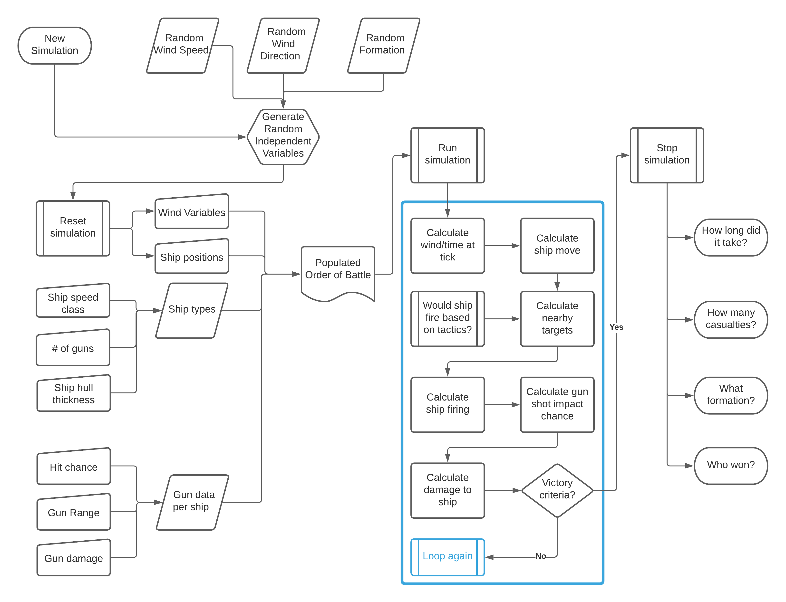
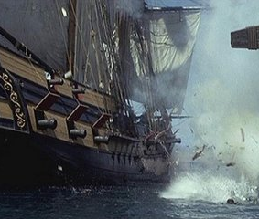
Conceptual Model: Flow Charts
Diagram 1 – Conceptual flow chart of modeling approach

Slide 8
Initial Model: Initialization Pseudocode
;; Fabricate Nation Types
Breed [British] [French] [Spanish]
;; Variables that effect the entire simulation
Globals [hours minutes time wind_direction wind_speed allow_sternway target_masts formation]
;; Agent-specific variables that will change throughout the simulation
Turtles-own [headwind health speed firepower compliment]
;; initial simulation setup
to setup
clear-all ;; reset simulation
reset-ticks ;; reset local timing
ask patches [ set pcolor 96] ;; make the ocean
create-British 27 ;; make 27 ships in the British Fleet
create-Spanish 15 ;; make 15 ships in the Spanish Fleet
create-French 18 ;; make 18 ships in the French Fleet
position-ships ;; call method to move ships to their specific order of battle
config-ships ;; configure all agents (ships)
ask turtles [
set color 65 ;; set to color green
set headwind 0 ;; initialize headwind to prevent strays after first cycle
]
ask British [ set shape "boat_br" ] ;; use custom sail color for British
ask French [ set shape "boat_fr" ] ;; use custom sail color for French
ask Spanish [ set shape "boat_sp" ] ;; use custom sail color for Spanish
end ;; end of method
;; start of simulation
to go
tick ;; one measurement of time
sail ;; move the boats (if they can)
set hours floor(ticks / 120) ;; count the hours passed
set minutes int (ticks / 2) mod 60 ;; count the minutes passed
set time (word hours ":" minutes) ;; display the time elapsed in a readable format
End
to sail
ask turtles [ ;; tell all ships individually
;; if the wind is on your left, calculate headwind advantage / disadvantage
if heading >= wind_direction [ set headwind ((135 - (heading - wind_direction))/ 135)]
;; if the wind is on your right, calculate headwind advantage / disadvantage
if heading < wind_direction [ set headwind ((135 - (wind_direction - heading))/ 135)]
if headwind < 0 [ ;; if there is no wind
if allow_sternway = 0 [ ;; and sternway (going backwards) is prohibited
set headwind 0 ;; prevent sternway due to TTPs
Initial test code written prior to model development. Key components include:
Nations in the battle
Turtle (ship) Attributes
Ship Types and Ratings
Environment initialization
Notes:
State your research question (less than 1 min). Remember to incorporate feedback from earlier presentations. Be clear exactly what it is you’ll be examining/measuring.

Slide 9
Initial Model: Implementing
Current Status: Troubleshooting. Issues being solved include:
formation switching
headwind simulation
ship-to-ship engagement
casualty/loss tracking
Simulation features completed include: Wind direction, speed, and time calculations, sternway controls, and turtle / patch structuring.
Notes:
State your research question (less than 1 min). Remember to incorporate feedback from earlier presentations. Be clear exactly what it is you’ll be examining/measuring.

Slide 10
References
Adkin, Mark. The Trafalgar Companion: a Guide to History's Most Famous Sea Battle and the Life of Admiral Lord Nelson. Aurum Press Ltd., 2007.
Goodwin, Peter. The Ships of Trafalgar: The British, French and Spanish Fleets, October 1805. Naval Institute Press, 2005.
Simons, Paul. “Weather Eye: the Battle of Trafalgar.” The Sunday Times, 21 Oct. 2015, www.thetimes.co.uk/article/weather-eye-the-battle-of-trafalgar-qkwf2fw6329.

